Slide 1

Deep Learning Based Text Independent Speaker Recognition
Group Number : 04
Sayba Kamal Orni | 2006009
Soumik Saha | 2006011
Adith Saha Dipro | 2006018
Nittya Ananda Biswas | 2006025

Slide 2
Introduction
Text independent speaker recognition.
Data acquisition.
Introduction to some speech features (Spectrogram, MFCC, Pitch, Short time energy (STE).
Use of various speech features to evaluate the uniqueness of speech from speaker to speaker.
Use of various Deep learning models to predict the speaker.

Slide 3
Objectives
To create a database of audio from different speakers.
Perform preprocessing on the database.
To visualize Mel-Spectrogram and MFCC of different speakers.
To convert a time series audio to an one layer image with the help of MFCC and Spectrogram.
Frame by frame analysis of an audio to understand the transition.
To build a suitable deep learning model and use this model to recognize any speaker from the database independent of what he/she says.

Slide 4
Workflow:
Audio Acquisition
Pre Processing
Feature Extraction
Model Training
Output Prediction

Slide 5
Audio Acquisition
We created our audio database for 8 speakers.
Each speaker has audio between 20-25 minutes.
Speaker review:-
Speaker-0 ----- Dipro (Group member, ID-2006018)
Speaker-1 ----- Enayet Chowdhury (Famous Bangldeshi Youtuber)
Speaker-2 ----- Farabi Hafiz (News Anchor)
Speaker-3 ----- Munjerin Shahid (Famous Bangldeshi Youtuber) Speaker-4 ----- Nittya (Group member, ID-2006025)
Speaker-5 ----- Orni (Group member, ID-2006009)
Speaker-6 ----- Soumik (Group member, ID-2006011
Speaker-7 ----- Zahid Ur Rahman (Talk show guest)
The speakers were allowed to speak anything.
Group members’ audios were recorded individually.
Youtubers’ audios were collected from youtube from different videos.

Slide 6
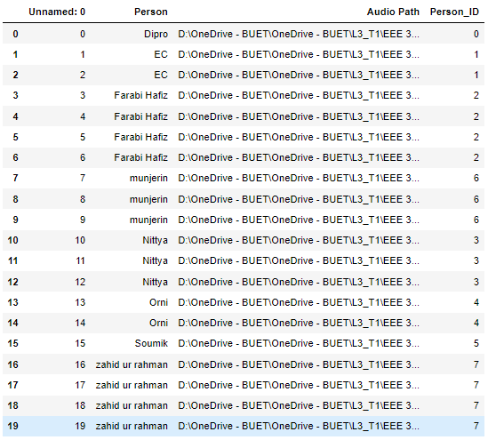
Audio Acquisition
Data Frame of audios from the Speakers

Slide 7
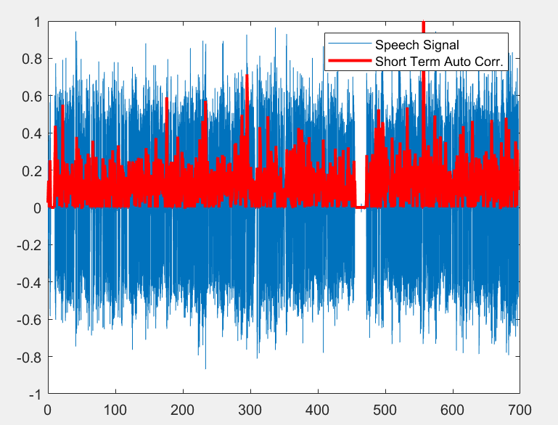
Preprocessing: Audio Silence Remove
Normalize the audio data
For framing inititalize frame length and compute frame size
Calulating the number of frames(data size/frame length)
Equally dividing the data in those frames
Then computing energy of the frames using short term autocorrelation
Plot the short term autocorrelation and main data at the same window

Slide 8
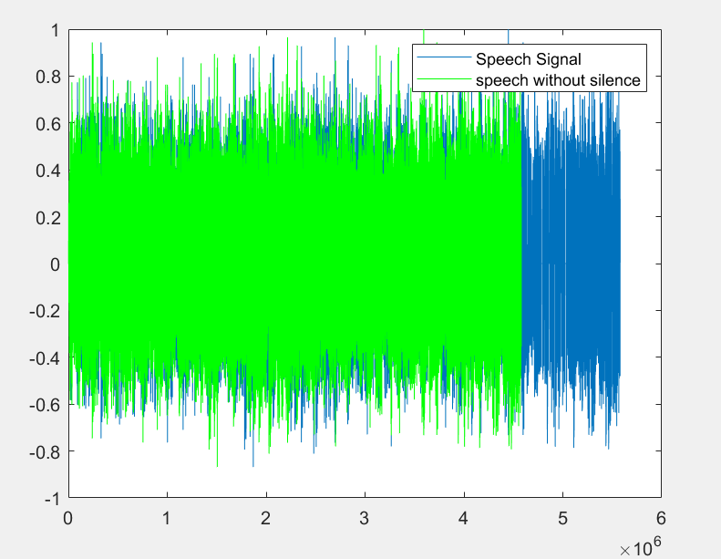
Preprocessing: Audio Silence Remove
Declare a threshold of STAC(in our case 0.015)
Finding the frames for which STAC values are greater than the threshold
Plot the silence removed data along with the main data in the same plot

Slide 9
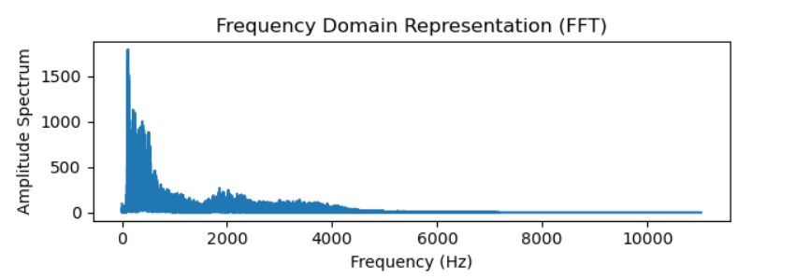
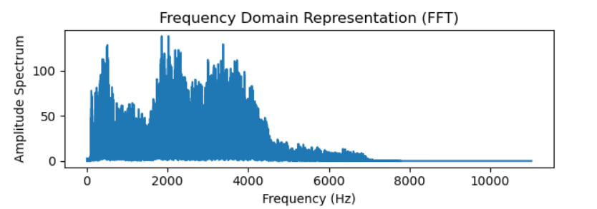
Preprocessing: Pre-Emphasis:
Frequency spectrum before pre-emphasis
Pre-emphasis is increasing the amplitude of high frequency bands and reducing the amplitudes of lower bands
We take an input audio and then use pre-emphasis on it using pre-emphasis coefficient 0.98.
After Pre-Emphasis we split the audios into smaller frames of 1 second and move on to feature extraction.
Frequency spectrum after pre-emphasis

Slide 10
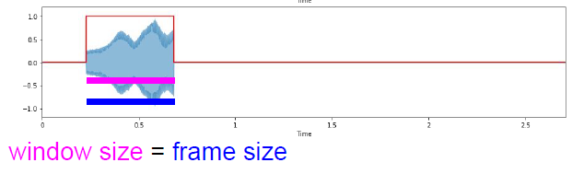
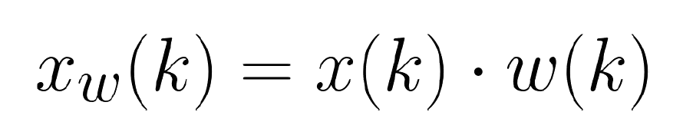
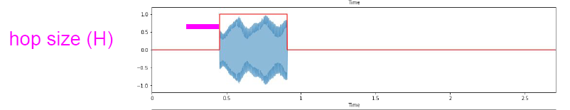
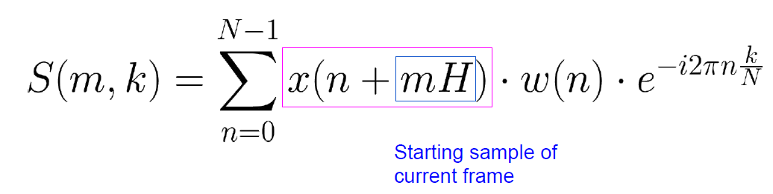
Mel Spectrogram:
Step 1:
Apply over-lapping windowing function to signal
We used Hann window for the windowing purposes. Window size=Frame Size=2048
Mathematical Equation for calculating STFT Hop size=512 Sampling Freq= 8k

Slide 11

Mel Spectrogram:
The STFT gives us a complex matrix as output.
Output =Spectral Matrix (Frequency bins(1025) , Frames(16))
Frequency Bins= $\frac{Framesize(2048)}{2}$ +1 = 1025
Frames= $\frac{Samples−Framesize}{Hopsize}$ +1 = 16

Slide 12
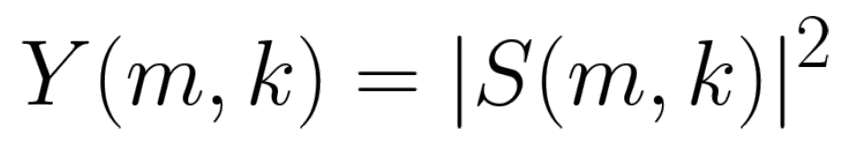
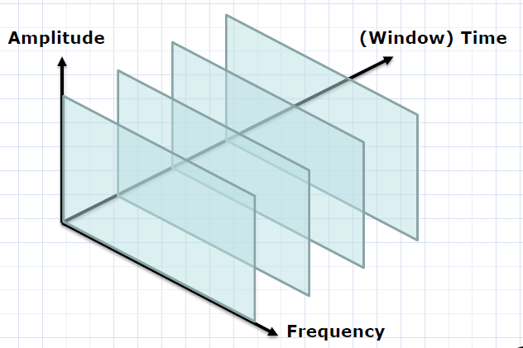
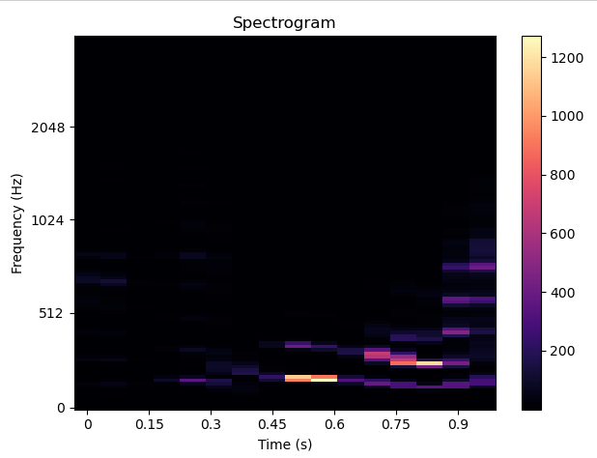
Mel Spectrogram:
Step 2:
Now the magnitude is taken from the output spectral matrix and we take logarithm of the amplitudes which ensures the scale is compatible with how we perceive the audio signal.
Now we can plot the spectra next to each other to generate a surface
Spectrogram Structure
Amplitude Spectrogram Of Speaker ID: 0

Slide 13
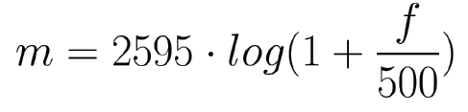
Mel Spectrogram:
Step 3:
Humans perceive frequency logarithmically so we need a Perceptually-relevant frequency representation. That’s why we use mel frequency where Equal distances on the scale have same “perceptual” distance.
Converting Frequency to mel scale:
We Choose number of mel bands (128)
And then we Construct mel filter banks
Finally Applying mel filter banks to spectrogram

Slide 14
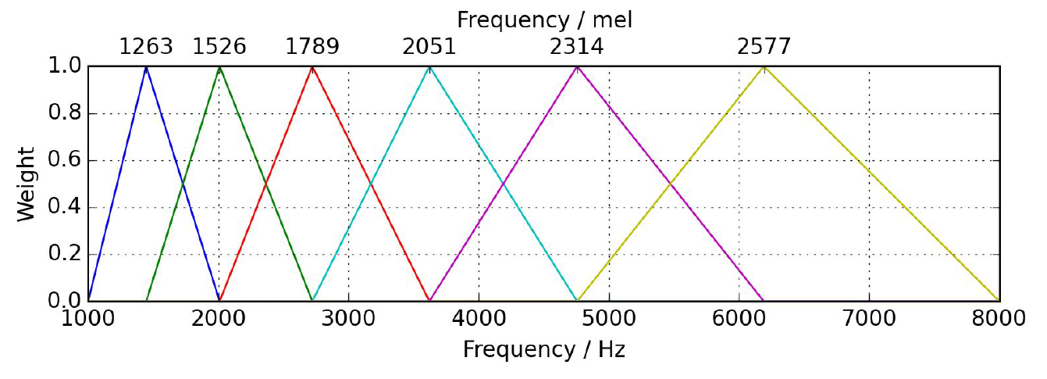
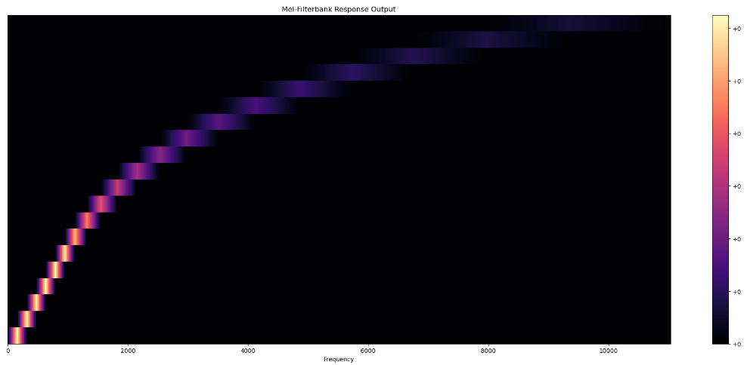
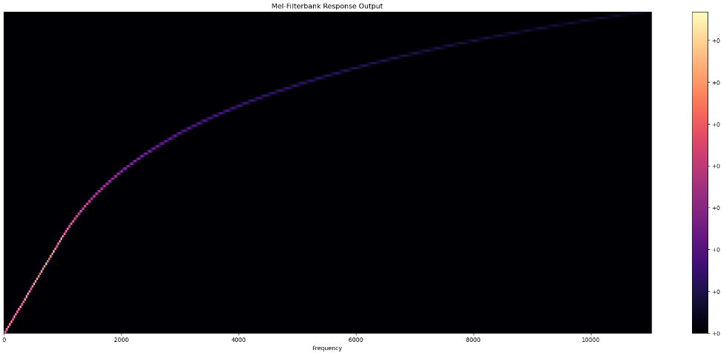
Mel Spectrogram:
Mel Filter Banks:
1.Convert lowest / highest frequency to Mel
2. Create 128 bands equally spaced points
3. Convert points back to Hertz
4. Round to nearest frequency bin
5. Create triangular filters
Mel Filter Bank For Mel Size of 6 (Demo)
Mel Filter Bank Response For Mel Size of 20 (Demo)
Mel Filter Bank Response For Mel Size of 128 (Used)

Slide 15
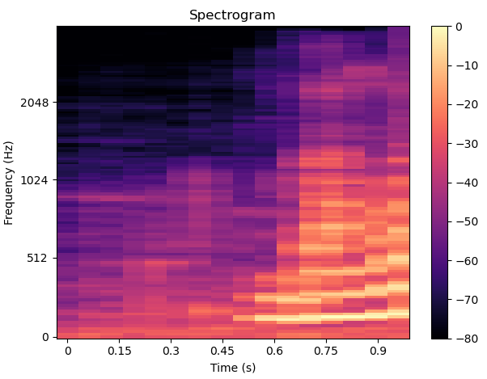
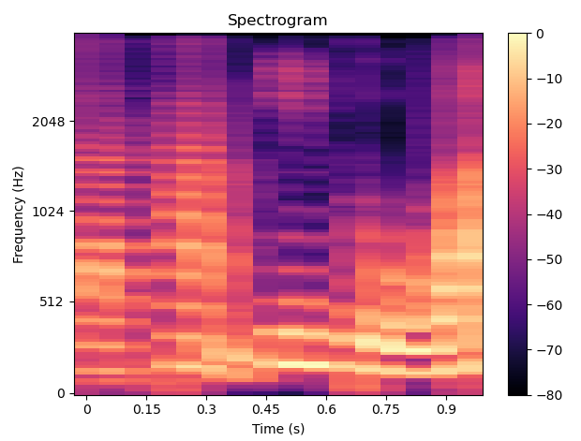
Mel Spectrogram:
Applying the mel filter bank on the spectrogram matrix we get the mel spectrogram matrix.
Spectrogram Matrix, Y=(1025, 16)
Mel Filter Matrix ,M= M_{(128 x 1025)}
Mel Spectrogram matrix, M’_{(128 x 16)} = M_{(128 x 1025)} Y_{(1025 x 16)}
Mel Spectrogram for Speaker ID -0
Mel Spectrogram for Speaker ID -1

Slide 16
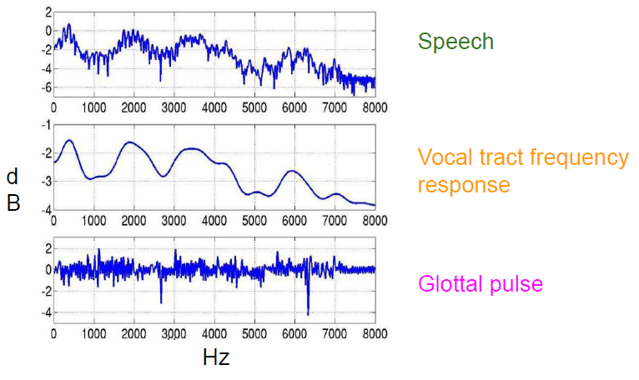
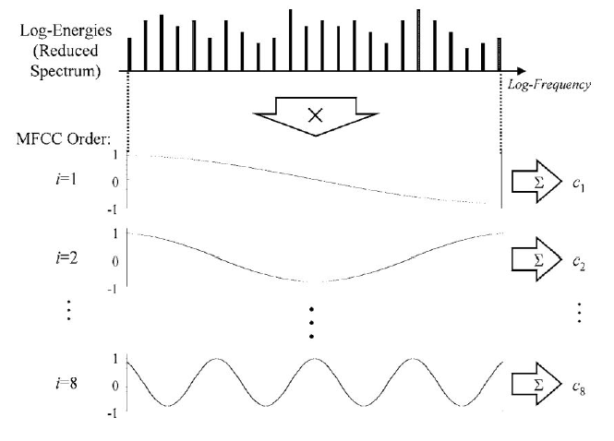
Mel-Frequency Cepstral Coefficients( MFCC)
Log Amplitude Spectrum
Mel- Scaling
Discrete Cosine Transform
Discrete Cosine Transform
We try to fit different frequency cosine wave in the log amplitude curve and how well that curve fits the log amplitude curve represents the MFCC coefficient for that particular frequency.
Waveform
STFT
MFCC

Slide 17
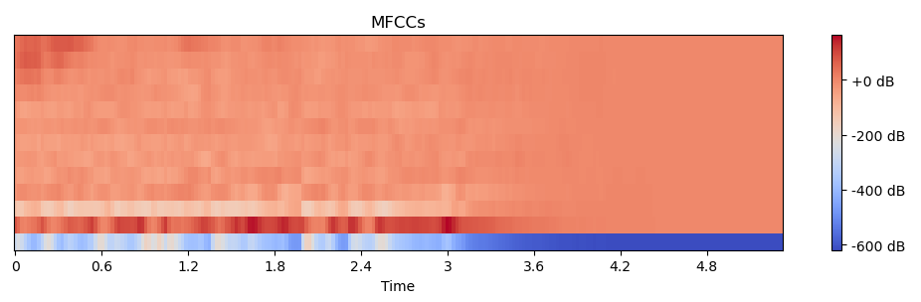
Mel-Frequency Cepstral Coefficients( MFCC)
We took first 13 coefficients as it covers most of the spectral information.
Use ΔMFCCs and ΔΔ MFCCs as we want to capture the temporal dynamics of speech signals, providing crucial information about how spectral characteristics change over time.
So, We have in total 39 coefficients per frame
MFFCs for Speaker ID 1

Slide 18
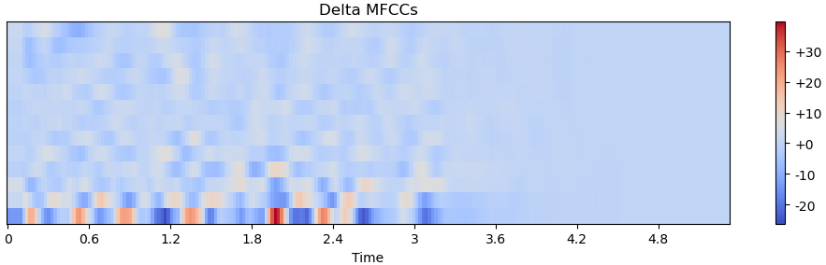
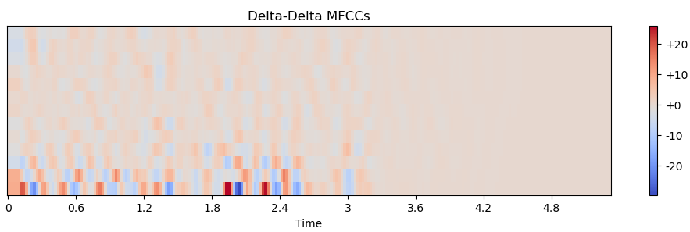
(Delta MFCC) and (Delta Delta MFCC)
Delta MFFCs for Speaker ID 1
Delta Delta MFFCs for Speaker ID 1

Slide 19
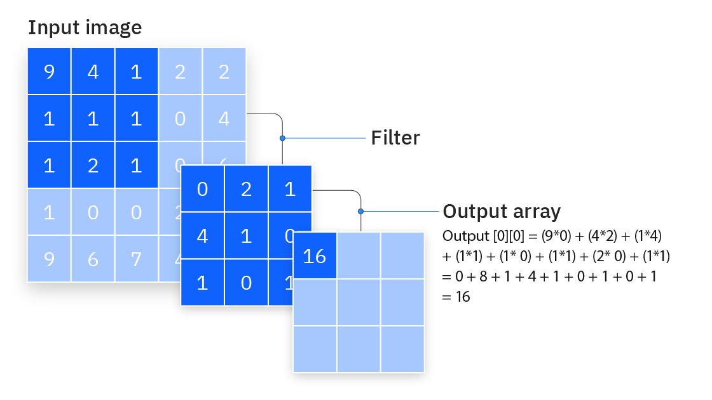
Deep Learning Model: Key Terms to know:-
Convolutional neural network (CNN) is a regularized type of feed-forward neural network that learns feature engineering by itself via filters (or kernel) optimization.
Convolution:
CNNs use filters (small grids of numbers) to scan across an image. This process is called convolution.
The filter looks for specific patterns or features in the image, like edges or textures.

Slide 20
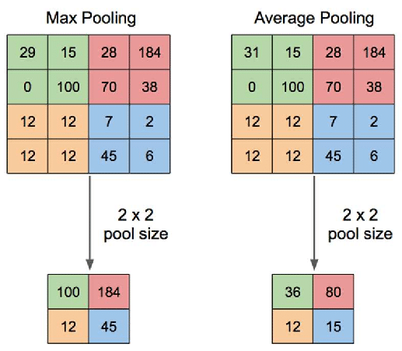
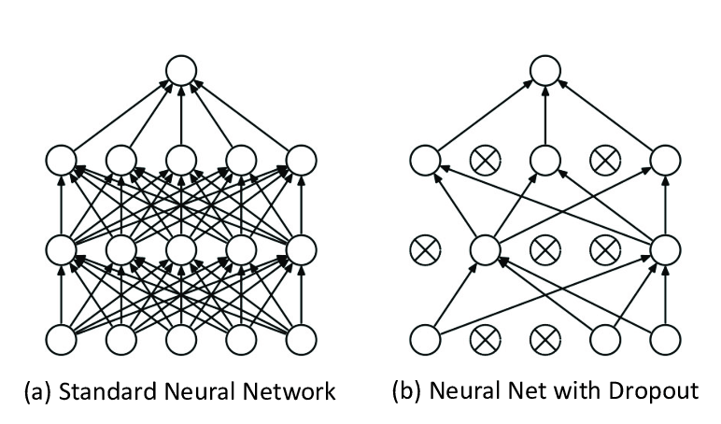
Deep Learning Model: Key Terms to know:-
Max pooling and average pooling is also used to
make the image size smaller after every filter
operation.
Dropout is also used to keep the
model from overfitting.

Slide 21
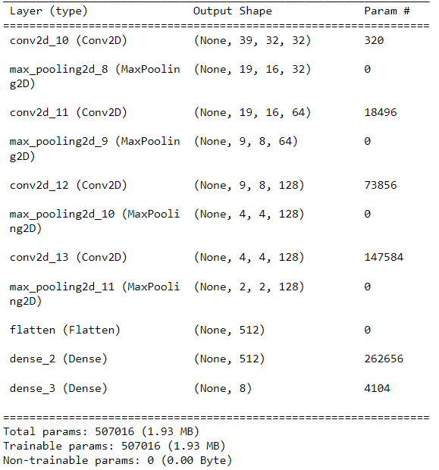
CNN Model:
We used a CNN model to predict the speaker.
Apart from this model we considered using-
Transfer Learning: A pre-trained model(trained on a
very large dataset.
RESNET-51: It requires 3 color channel and is requires
very powerful processing capability for a PC.
3. Ultimately we used the model displayed on the right
due to its simplicity, swift trainability and good accuracy.
Used Models Architecture

Slide 22
Training The model
We used 4 different types of speech features to train the model-
Mel-spectrogram
Mel-spectrogram clumped with the delta and delta deltas of Mel-spectrogram.
MFCC, delta and delta delta of MFCC clumped together.
MFCC, delta and delta delta of MFCC clumped with spectrogram.

Slide 23
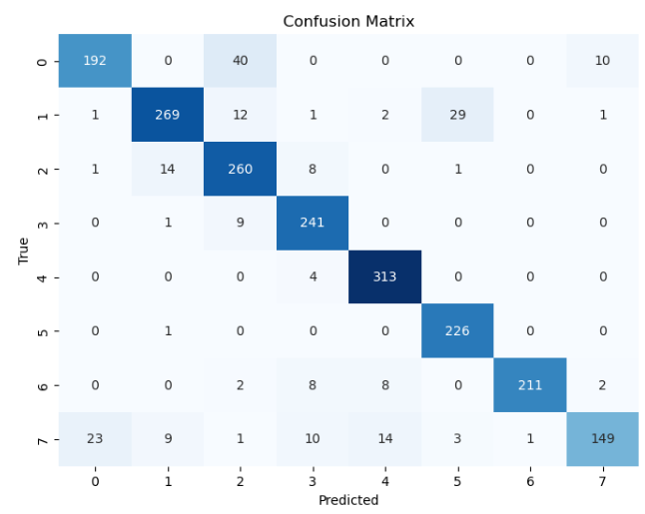
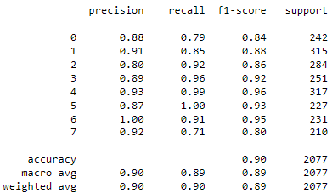
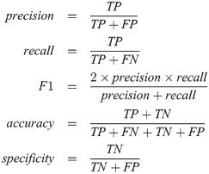
Evaluation of Accuracy and Confusion Matrix
Mel-spectrogram

Slide 24
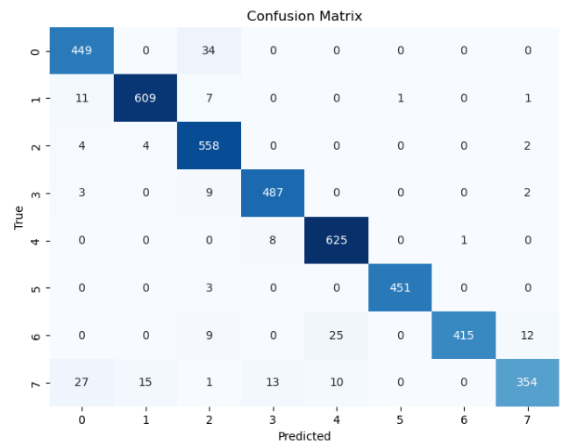
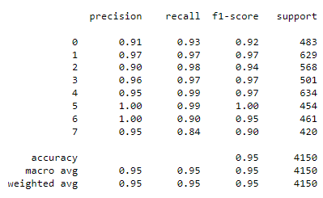
Evaluation of Accuracy and Confusion Matrix
MFCC, delta and delta delta of MFCC clumped together

Slide 25
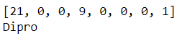
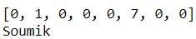
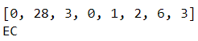
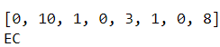

Final Verdict On Any Audio Outside the Primary Database
Splits the input audio (preprocessed) into frames of 1 second.
Make the model vote for every frame. (On which speaker it is).
Take the majority vote to be the output.
Dipro – Speaker 0
Successful
Soumik – Speaker 5
Successful
Enayet (EC) – Speaker 1
Successful
Munjerin – Speaker 6
Unsuccessful

Slide 26


